Slide 1
Query Optimization
— Chapter 16
2021年12月
叶文
yewen@bupt.edu.cn
School of Computer Science (National Pilot Software Engineering School)

Slide 2
C, C++, Java programs
query
程 序 编 译 / 编译器
词法/语法/语义分析
Query processing / DBMS
扫描和语法/语义分析
中间代码生成
关系代数表达式&查询树
Chapter15, 16
(中间)代码优化
查询优化
(§13)
(优化后)查询执行计划
目标代码生成
查询代码生成
(§12)
目标程序代码
查询计划执行的代码
process / thread
事务处理 / DBMS
transaction
程序执行 /
进程管理
&进程调度
并发控制
死锁处理
事务管理
&事务调度
并发控制
恢复技术
Chapter 17, 18, 19
死锁处理
OS
(§19)
(§17)
(§18)
Fig. 15.0.1

Slide 3
Outline
Introduction
Transformation of Relational Expressions
Estimating of Statistics of Expression Results
Choice of evaluation plans — Query optimization
cost-based optimization,§16.4.1/16.4.2
heuristic optimization, §16.4.3
Why query optimization needed
equivalence rules
for the purpose of estimating query evaluation paln costs

Slide 4
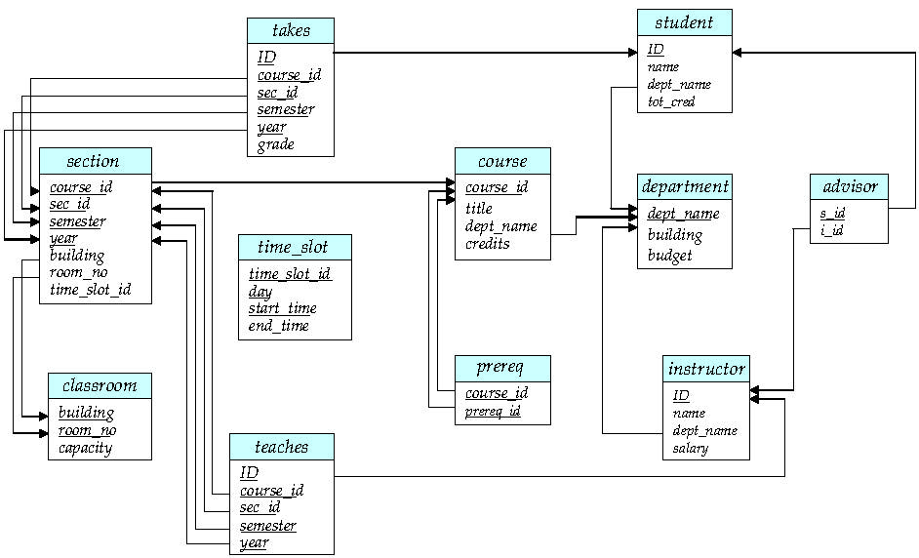
return

Slide 5
13.1 Overview
A SQL query statement may corresponds to several equivalent expressions ( or query evaluation plans ), each of which may have different costs
Query optimization is needed to choice an efficient query-evaluation plan with lower costs
E.g.1. select *
from r, s
where r.A = s.A
σ_{r.A=s.A} (r ╳ s) is much slower than r s

Slide 6
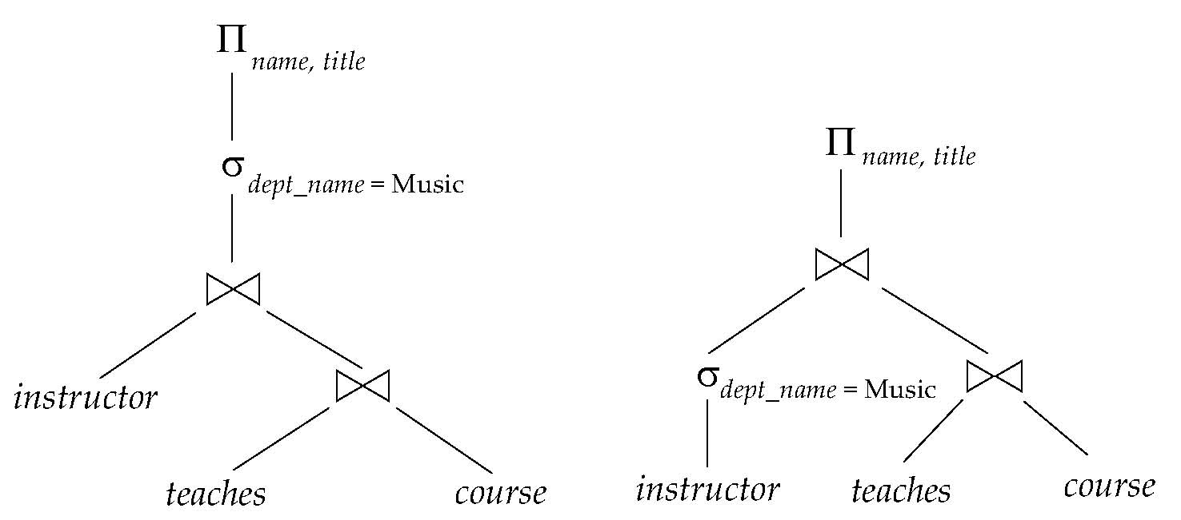
Overview
E.g.2 Find the names of all instructors in the Music department together with the course title of all the courses that the instructors teach
Alternative ways of evaluating a given query
equivalent expressions, but with different query cost
different algorithms for each operation

Slide 7
Overview
An evaluation plan defines exactly what algorithm is used for each operation, and how the execution of the operations is coordinated
Fig.16.2 An evaluation plan

Slide 8
Overview
Cost difference between equivalent evaluation plans for a query can be enormous
e.g. seconds vs days in some cases
Appendix 16-2 Distributed DBS查询代价与数据分布的关系
1s vs 2.3 days
一次非常有意思的SQL优化经历: 从30248.271s到0.001s
https://zhuanlan.zhihu.com/p/65203585?utm_source=com.android.email&utm_medium=social&utm_oi=679111968938397696
好 SQL”还是“烂 SQL”？看 OceanBase 查询改写的最佳实践（分享自知乎网）https://zhuanlan.zhihu.com/p/69115184?utm_source=com.android.email&utm_medium=social&utm_oi=679111968938397696
OceanBase 2.0 到底如何做到 50% 的性能提升？（分享自知乎网）2.0 解析系列终篇 | https://zhuanlan.zhihu.com/p/50620154?utm_source=com.android.email&utm_medium=social&utm_oi=679111968938397696

Slide 9
高效SQL查询
合理设置索引，提高select/update执行效率
利用DBMS，观察SQL语句的查询执行计划/过程，分析执行过程是否合理，有无改进优化余地
避免在where子句中嵌入select查询子句
select … from …
where s_id in {select * from …}
避免在一个复杂查询中，1个关系表作为查询对象，出现多次
select … from S, …
where id in {select * from S join …}

Slide 10
Query Optimization Procedure
Step 1. Generating the equivalent expressions/query trees, by transforming of relational algebra expressions according to equivalence rules in§16.2
Step 2. Generating alternative evaluation plans, by annotating the resultant equivalent expressions with implementation algorithms for each operations in the expressions
Step 3. Choosing the optimal (that is, cheapest) or near-optimal plan based on the estimated cost (§16.3 ), by
cost-based optimization
heuristic optimization

Slide 11
Cost Estimation
The cost of operations is needed to estimate based on
statistical information about relations
examples:
number of tuples, number of distinct values for an attribute
statistics estimation for intermediate results
to compute cost of complex expressions
estimation by sampling
—e.g. 客户表有5000万个元组，抽取少部分（e.g. <1%）元组，统计客户的年龄、籍贯分布
cost formulae for algorithms (e.g. merge-join), computed using statistics

Slide 12
16.2 Transformation of Relational Expressions
Equivalent Expression
two relational algebra expressions are equivalent, if on every legal database instances, the two expression generate the same set of tuples
Using the following equivalent rules to transform relational expression in query optimization

Slide 13
Equivalence Rules
Rule 1.(选择串接律, 将1个选择操作分解为2个选择操作) Conjunctive selection operations can be deconstructed into a sequence of individual selections
e.g. refer to
Rule 2. (选择交换律) Selection operations are commutative :

Slide 14
Equivalence Rules
Rule 3. (投影串接律) Only the final operation in a sequence of project operations is needed
note: it is required that L₁⊆ L₂⊆ ….⊆ L_{n}
e.g. ∏ _{{ID}} { ∏ _{{ID, name}} (instructor) }
= ∏ _{{ID}} (instructor)
…
…

Slide 15
Equivalence Rules
Rule 4. (以连接操作代替选择和笛卡尔乘积) Selections can be combined with Cartesian products and theta joins
a. σ_{θ}(E₁ ╳ E₂) = E₁ _{θ} E₂
note: definition of θ join
b. σ_{θ1}(E₁ _{θ2} E₂) = E₁ _{θ1∧ θ2} E₂
e.g. σ _{dept-name=“Music”}( instructor teaches) =
instructor (dept-name=“Music) ∧ (instructor.ID=teaches.ID) teaches
Using Rule4 to reduce the number of operations, and the costs of the right-hand expressions are less than that of the left-hand expressions
often used in heuristic query optimizing

Slide 16
Equivalence Rules
Rule 5 (连接操作可交换) Theta join operations are commutative
E_{1 θ} E₂ = E₂ _{θ} E₁
Fig. 16.3
!! the expression with smaller size should be arranged as the left one in join operation
连接操作中，relation of smaller size作为outer relation，以降低the cost of join operation

Slide 17
r
s
连接属性A
t₁.A
t₂.A
t₁
t₂
|r|=m
|s|=n
原理： 针对r中元组t₁，检查s中的元组t₂.A，t₁.A=t₂.A ?
方法：
For r中每个元组t₁ //*扫描
按照t₁.A，查找s中满足t₁.A=t₂.A的元组t₂，
合并元组t₁和t₂

Slide 18
Equivalence Rules
假设
1. |r|=m，|s|=n
2. m<n, n/m =k >1
给定r中的元组t₁，采用B/B⁺树索引、二分搜索机制，根据t₁.A，查找s中满足t₁.A=t₂.A的元组t₂，树的degree为d，所需cost正比于树高，为：
O(log_{d}n)
r s的cost为： O(m + mlg_{d}n)
s r的cost为： O(n + nlg_{d}m)
如果没有索引：
O(m + m * n) vs O(n + n * m)
O(m + m * n) =O(m*n) =O(n + n * m)

Slide 19
m+ mlgn vs n + nlgm
m<n, n/m =k >1, n=k*m
nlgm - mlgn
= k*mlgm – m(lgk*m )
= k*mlgm – mlgk- mlgm
= (k-1)mlgm – mlgk
一般情况下，(k-1)mlgm > mlgk
e.g. |r|=m=500，|s|=n=1000, k = n/m =2
(k-1)mlgm =500lg500 > mlgk=500lg2

Slide 20
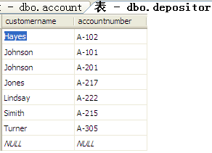
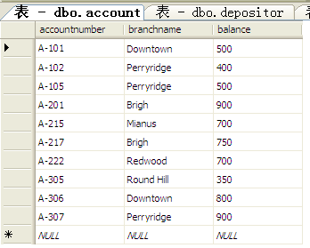
r: depositor, |r| = 7
s: account, |s| = 10
select *
from depositor inner join account
on depositor.accountnumber=account.accountnumber
select *
from account inner join depositor
on account.accountnumber=depositor.accountnumber

Slide 21
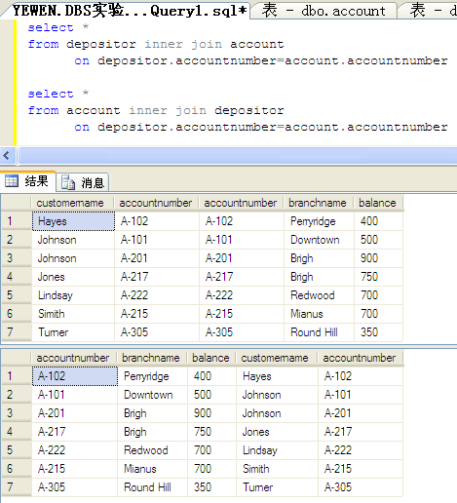

Slide 22
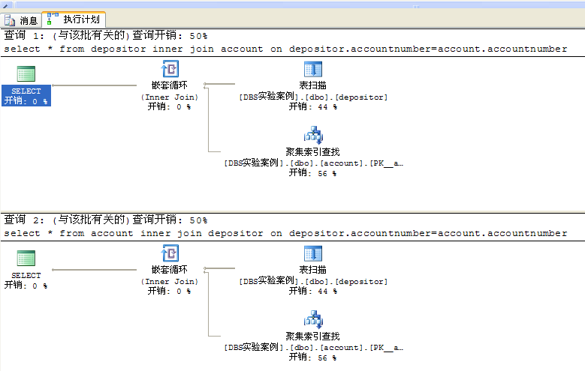
SQL Server查询优化器自动选择元组数少的depositor作为连接操作的outer关系，两条语句的查询执行计划、执行成本一样
outer关系
outer关系

Slide 23
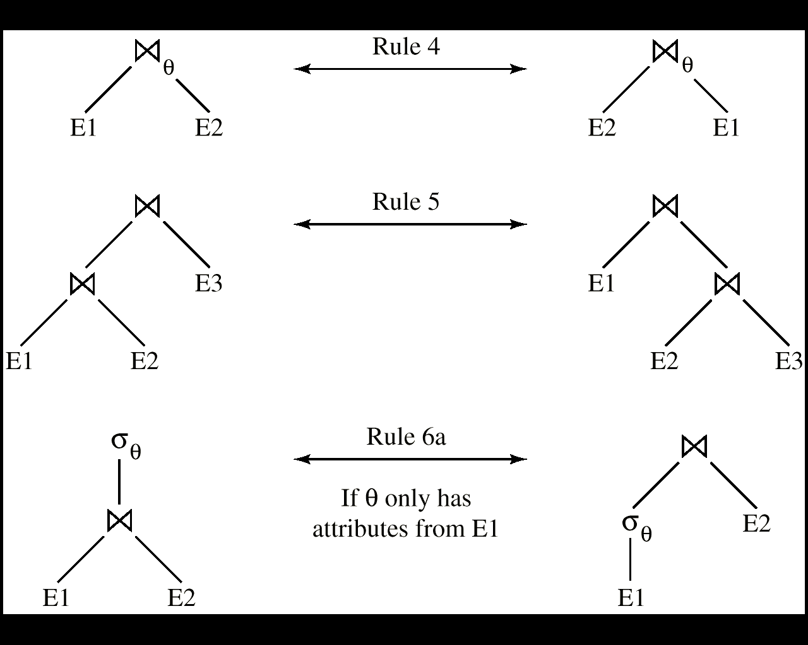
Equivalence Rules
Rule 5
Rule 6a
Rule 7a
Fig.16.3 Pictorial Depiction of Equivalence Rules

Slide 24
Equivalence Rules
Rule 6. (连接操作的结合率, associative)
a. natural join operations are associative
(E1 E2) E3 = E1 (E2 E3)
b. Theta joins are associative in the following manner: (E_{1 θ1} E₂) _{θ2∧ θ 3} E₃ = E_{1 θ1∧ θ3} (E₂ _{θ2} E₃)
, where θ₂ involves attributes from only E₂ and E₃

Slide 25
Equivalence Rules
Rule 7. Selection operation distributes over theta-join(选择操作对于连接操作的分配率,选择条件下移)
a. when all the attributes in θ₀ involve only the attributes of one of the expressions , e.g. E₁, being joined σ_{θ0}(E₁ _{θ} E₂) = (σ_{θ0}(E₁)) _{θ} E₂
b. when θ ₁ involves only the attributes of E₁, and θ₂ involves only the attributes of E₂
σ_{θ1}∧_{θ2} (E₁ _{θ} E₂) = (σ_{θ1}(E₁)) _{θ} (σ_{θ2} (E₂))
e.g. in Fig.16.0.2

Slide 26
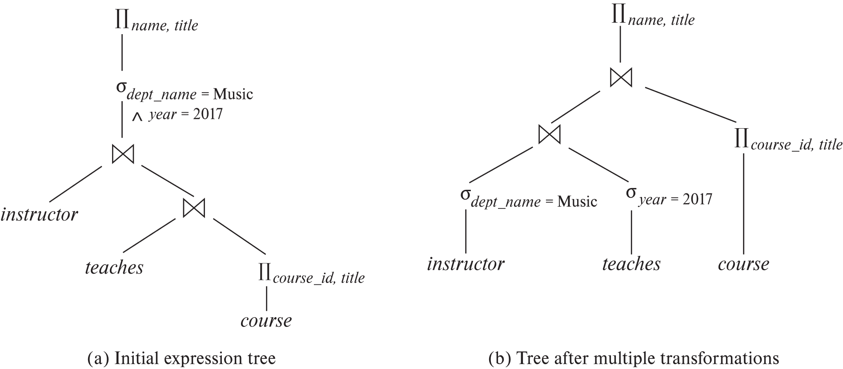
Example: Rule 7
When Rule 7 is applied, the size of relations participating in theta-join operation is reduced, thus evaluation costs are reduced
Fig.16.0.2 An example of Rule 7

Slide 27
Equivalence Rules
Rule 8. Projection operation distributes over theta-join(投影操作对于连接操作的分配率,投影下移)
a. L₁ and L₂ are the attributes of E₁ and E₂ respectively. if join condition θ involves only attributes in L₁ ∪ L₂, then

Slide 28
E1:
instructor (ID, name, dept-name, salary)
E2:
department(dept-name, building, budget)
L1
L2
∏ _{{dept-name, ID} ∪} _{{dept-name, budget}}
只选后续用到的属性！
instructor
department
∏_{{dept-name, ID}}
∏ _{{dept-name, budget}}
instructor
department
Fig.16.0.3 An example of Rule 8a

Slide 29
Equivalence Rules
b. consider a join E_{1 θ} E₂
let L₁ and L₂ be sets of attributes from E₁ and E₂, respectively
let L₃ be attributes of E₁ that are involved in join condition θ, but are not in L₁ ∪ L₂, and
let L₄ be attributes of E₂ that are involved in join condition θ, but are not in L₁ ∪ L₂.

Slide 30
E1:
instructor (ID, name, dept-name, salary)
L1
L2
E2:
department(dept-name, building, budget)
∏ _{{name} ∪} _{{ building}}
θ
∏ _{{name} ∪} _{{ building}}
Salary< budget
L3
L4
instructor
department
salary> budget
∏ _{{name, salary}}
∏ _{{building, budget}}
只选后续用到的属性！
instructor
department
Fig.16.0.4 An example of Rule 8b

Slide 31
Equivalence Rules
Rule 9. The set operations union and intersection are commutative E₁ ∪ E₂ = E₂ ∪ E₁ E₁ ∩ E₂ = E₂ ∩ E₁
set difference is not commutative
Rule 10. Set union and intersection are associative
(E₁ ∪ E₂) ∪ E₃ = E₁ ∪ (E₂ ∪ E₃) (E₁ ∩ E₂) ∩ E₃ = E₁ ∩ (E₂ ∩ E₃)

Slide 32
Equivalence Rules
Rule11. (选择操作对于集合并、交、差的分配率) The selection operation distributes over ∪, ∩ and –.
σ_{θ} (E₁ – E₂) = σ_{θ} (E₁) – σ_{θ}(E₂)
similarly for ∪ and ∩ in place of –
σ_{θ} (E₁ – E₂) = σ_{θ}(E₁) – E₂
similarly for ∩ in place of –, but not for ∪
Rule12. (投影操作对于集合并的分配率) The projection operation distributes over union
Π_{L}(E₁ ∪ E₂) = (Π_{L}(E₁)) ∪ (Π_{L}(E₂))

Slide 33
Example One: Pushing Selections
Query: Find the names of all instructors in the Music department, along with the titles of the courses that they teach
Π_{name, title}(σ_{dept_name= “Music”} {instructor (teaches Π_{course_id, title} (course))})
Transformation using rule 7a.
Π_{name, title}((σ_{dept_name= “Music”}(instructor)) (teaches Π_{course_id, title} (course)))
Performing the selection as early as possible reduces the size of the relation to be joined.

Slide 34
Example Two：Multiple Transformations
Find the names of all instructors in the Music department who have taught a course in 2019, along with the titles of the courses that they taught
Π_{name, title}(σ_{dept_name= “Music”∧year = 2019} (instructor (teaches Π_{course_id, title} (course))))
Transformation using join associatively (Rule 6a):
Π_{name, title}(σ_{dept_name= “Music”∧year = 2019} ((instructor teaches) Π_{course_id, title} (course)))
Second form provides an opportunity to apply the “perform selections early” rule, resulting in the subexpression, by using Rule 7
σ_{dept_name = “Music”} (instructor) σ _{year = 2019} (teaches)

Slide 35
Example Three: Pushing Projections
Consider: Π_{name, title}(σ_{dept_name= “Music”} (instructor) teaches) Π_{course_id, title} (course))))
When we compute
(σ_{dept_name = “Music”} (instructor teaches)
we obtain a relation whose schema is: (ID, name, dept_name, salary, course_id, sec_id, semester, year)
Push projections using equivalence rules 8a and 8b; eliminate unneeded attributes from intermediate results to get: Π_{name, title}(Π_{name, course_id} ( σ_{dept_name= “Music”} (instructor) teaches)) Π_{course_id, title} (course))))
Performing the projection as early as possible reduces the size of the relation to be joined.

Slide 36
16.2.3 Join Ordering
For all relations r_{1,} r_{2,} and r₃,
(r₁ r₂) r₃ = r₁ (r₂ r₃ )
If r₂ r₃ is quite large and r₁ r₂ is small, we choose
(r₁ r₂) r₃
so that we compute and store a smaller temporary relation.

Slide 37
Example
Consider the expression
Π_{name, title}(σ_{dept_name= “Music”} (instructor) teaches Π_{course_id, title} (course))))
Could compute teaches Π_{course_id, title} (course) first, and join result with σ_{dept_name= “Music”} (instructor) but the result of the first join is likely to be a large relation.
Only a small fraction of the university’s instructors are likely to be from the Music department
it is better to compute
σ_{dept_name= “Music”} (instructor) teaches
first.

Slide 38
16.3 Estimating Statistics of Expression Results【略】
How to estimate the cost of an operation p
step1. estimating the size of the resultant relations produced by the operation p, according to statistics in the catalog about the relations on which the operation is conducted
e.g. ∏_{customer-name}(σ_{balance<2500}(account) customer)
step2. computing the cost of the operation in terms of disk access, by means of the cost formulae shown in chapter15
disk access is the predominant cost, and the number of block transfers from disk is used as a measure of the actual cost of evaluation.

Slide 39
Catalog Information
n_{r}: number of tuples in a relation r, e.g. 1000
b_{r}: number of blocks containing tuples of r, 100
l_{r}: size of a tuple of r in bytes, 20 bytes
Size of r = l_{r} * n_{r} , e.g. 20 bytes* 1000
f_{r}: blocking factor of r, 10
the number of tuples of r that fit into one block
V(A, r): number of distinct values that appear in r for attribute A
same as the size of ∏_{A}(r), | ∏_{A}(r)|
e.g. ∏_{course_id} (course)=500
If tuples of r are stored together physically in a file, then:
Statistics about indices, such as heights of B⁺-trees, that is HT_{i}, and the number of leaf pages in the indices, are also in catalog

Slide 40
Example
Running example: student ⨝ takes
Catalog information for join examples:
n_{student} = 5,000.
f_{student} = 50, which implies that b_{student} =5000/50 = 100.
n_{takes} = 10000
f_{takes} = 25, which implies that b_{takes} = 10000/25 = 400.
V(ID, student) = 5000 (primary key!)
V(dept_name, student) =20
V(ID, takes) = 2500, which implies that on average, each student who has taken a course has taken 4 courses
n_{takes} / V(ID, takes) = 10000/2500 = 4
attribute ID in takes is a foreign key referencing student

Slide 41
Histograms
Histogram on attribute age of relation person
Equi-width histograms
Equi-depth histograms break up range such that each range has (approximately) the same number of tuples
E.g. (4, 8, 14, 19)
Many databases also store n most-frequent values and their counts
Histogram is built on remaining values only

Slide 42
Histograms
Histograms and other statistics usually computed based on a random sample
Statistics may be out of date
some database require a analyze command to be executed to update statistics
others automatically recompute statistics
e.g., when number of tuples in a relation changes by some percentage

Slide 43
Selection Size Estimation
The size estimation of the result of a selection operation depends on the selection predicates, that is single equality predicate, single comparison predicate, and combination of predicates
Equality selection σ_{A=a} (r)
assuming uniform distribution (?) of values in relations, and the value a appears in attribute A of some record in r
the selection is estimated to have
n_{r} / V(A, r) tuples satisfying A=a
e.g. n_{student} /V(dept_name, student) = 5000/20=500
⎡n_{r} /V(A, r) /f_{r}⎤ =500/50=10 blocks that these tuples occupy
equality condition on a key attribute (e.g. ID=2019211): size estimate = 1

Slide 44
Selection Size Estimation
Comparison selections σ_{A≤v}(r)
case of σ_{A ≥ V}(r) is symmetric
the lowest and highest values of attributes, that is min(A, r) and max(A, r), are available in catalog
the estimated number of records/tuples satisfying comparison condition A≤ V
0, if v < min(A, r)
n_{r}, if v ≥ max(A, r)
, otherwise
If histograms available, can refine above estimate
in absence of statistical information, the cost is assumed to be
n_{r} / 2

Slide 45
Size Estimation of Complex Selections
The selectivity of a condition θ_{i} is the probability that a tuple in the relation r satisfies θ_{i} .
If s_{i} is the number of satisfying tuples in r, the selectivity of θ_{i} is given by s_{i} /n_{r}.
Conjunction: σ_{θ1∧ θ2∧. . . ∧ θn} (r). Assuming independence, estimate of tuples in the result is:
Disjunction:σ_{θ1∨} _{θ2 ∨. . . ∨} _{θn} (r). Estimated number of tuples:
Negation: σ_{¬θ}(r). Estimated number of tuples: n_{r} – size(σ_{θ}(r))

Slide 46
Estimation of the Size of Joins
The Cartesian product r x s contains n_{r} .n_{s} tuples; each tuple occupies s_{r} + s_{s} bytes.
If R ∩ S = ∅, then r ⋈ s is the same as r x s.
If R ∩ S is a key for R, then a tuple of s will join with at most one tuple from r
therefore, the number of tuples in r ⋈ s is no greater than the number of tuples in s.
If R ∩ S in S is a foreign key in S referencing R, then the number of tuples in r ⋈ s is exactly the same as the number of tuples in s.
The case for R ∩ S being a foreign key referencing S is symmetric.
In the example query student ⋈ takes, ID in takes is a foreign key referencing student
hence, the result has exactly n_{takes} tuples, which is 10000

Slide 47
Estimation of the Size of Joins (Cont.)
If R ∩ S = {A} is not a key for R or S. If we assume that every tuple t in R produces tuples in R S, the number of tuples in R ⨝ S is estimated to be: If the reverse is true, the estimate obtained will be: The lower of these two estimates is probably the more accurate one.
Can improve on above if histograms are available
Use formula similar to above, for each cell of histograms on the two relations

Slide 48
Estimation of the Size of Joins (Cont.)
Compute the size estimates for student ⨝ takes without using information about foreign keys:
V(ID, takes) = 2500, and V(ID, student) = 5000
The two estimates are 5000 * 10000/2500 = 20,000 and 5000 * 10000/5000 = 10000
We choose the lower estimate, which in this case, is the same as our earlier computation using foreign keys.

Slide 49
Size Estimation for Other Operations
Projection: estimated size of ∏_{A}(r) = V(A,r)
Aggregation : estimated size of _{G}𝛾_{A}(r) = V(G,r)
Set operations
For unions/intersections of selections on the same relation: rewrite and use size estimate for selections
E.g., σ_{θ1} (r) ∪ σ_{θ2} (r) can be rewritten as σ_{θ1 or θ2} (r)
For operations on different relations:
estimated size of r ∪ s = size of r + size of s.
estimated size of r ∩ s = minimum size of r and size of s.
estimated size of r – s = r.
All the three estimates may be quite inaccurate, but provide upper bounds on the sizes.

Slide 50
Size Estimation (Cont.)
Outer join:
Estimated size of r ⟕ s = size of r ⨝ s + size of r
Case of right outer join is symmetric
Estimated size of r ⟗ s = size of r ⨝ s + size of r + size of s

Slide 51
Estimation of Number of Distinct Values
Selections: σ_{θ} (r)
If θ forces A to take a specified value: V(A,σ_{θ} (r)) = 1.
e.g., A = 3
If θ forces A to take on one of a specified set of values: V(A,σ_{θ} (r)) = number of specified values.
(e.g., (A = 1 V A = 3 V A = 4 )),
If the selection condition θ is of the form A op r estimated V(A,σ_{θ} (r)) = V(A.r) * s
where s is the selectivity of the selection.
In all the other cases: use approximate estimate of min(V(A,r), n_{σθ (r)} )
More accurate estimate can be got using probability theory, but this one works fine generally

Slide 52
Estimation of Distinct Values (Cont.)
Joins: r ⨝ s
If all attributes in A are from r estimated V(A, r ⨝ s) = min (V(A,r), n _{r ⨝ s})
If A contains attributes A1 from r and A2 from s, then estimated V(A,r ⨝ s) =
min(V(A1,r)*V(A2 – A1,s), V(A1 – A2,r)*V(A2,s), n_{r ⨝ s})
More accurate estimate can be got using probability theory, but this one works fine generally

Slide 53
Estimation of Distinct Values (Cont.)
Estimation of distinct values are straightforward for projections.
They are the same in ∏_{A (r)} as in r.
The same holds for grouping attributes of aggregation.
For aggregated values
For min(A) and max(A), the number of distinct values can be estimated as min(V(A,r), V(G,r)) where G denotes grouping attributes
For other aggregates, assume all values are distinct, and use V(G,r)

Slide 54
16.4 Choice of Evaluation Plans: Query optimization
How to generate the evaluation plan for a relational algebra expression with lower or the lowest cost
generating of the optimized query trees
selecting
implementation algorithms for each operations in the tree
pipeline or materialization strategy for the expression
Query optimization
choosing the evaluation plan with lowest or the lower cost

Slide 55
Example
Fig.16.2 An evaluation plan

Slide 56
Choice of Evaluation Plans
Must consider the interaction of evaluation techniques when choosing evaluation plans
choosing the cheapest algorithm for each operation independently may not yield best overall algorithm. E.g.
merge-join may be costlier than hash-join, but may provide a sorted output which reduces the cost for an outer level aggregation.
nested-loop join may provide opportunity for pipelining

Slide 57
Two Approaches for Choice of Evaluation Plans
Practical query optimizers incorporate elements of the following two broad approaches:
1. Cost-based (16.4.1, 16.4.2)【略】
Search all the plans and choose the best plan in a cost-based fashion.
2. heuristic optimization (16.4.3)【掌握！】
Uses heuristics to choose a plan
Practical query optimizers incorporate elements of these two approaches

Slide 58
13.4.1 Cost-Based Join Order Selection 【略】
The join operator is the basis for multiple table query, and its cost is expensive
For a relational algebra expression with several join operation
, the join order influences the query cost of the expression.
Consider finding the best join-order for r₁ r₂ . . . r_{n}.
There are (2(n – 1))!/(n – 1)! (?) different join orders for above expression. With n = 7, the number is 665280, with n = 10, the number is greater than 176 billion!
No need to generate all the join orders. Using dynamic programming, the least-cost join order for any subset of {r₁, r₂, . . . r_{n}} is computed only once and stored for future use.
类似于算法设计与分析中的矩阵连乘积
(A₁A₂…A_{i-1}A_{i}A_{i+1}…A_{n})

Slide 59
Join Order Selection by Dynamic Programming【略】
No need to generate all the join orders. Using dynamic programming, the least-cost join order for any subset of {r₁, r₂, . . . r_{n}} is computed only once and stored for future use
方法
Fig.16.7
类似于《算法设计与分析》中的矩阵连乘积

Slide 60
16.4.2 Cost-based Optimization with Equivalence Rules 【略】
Cost-based optimization
search all?? the possible plans and choose the best plan
a optimal plan with the minimum costs can be obtained
Cost-based optimization is expensive
Physical equivalence rules allow logical query plan to be converted to physical query plan specifying what algorithms are used for each operation.

Slide 61
Cost-based Optimization with Equivalence Rules
Efficient optimizer based on equivalent rules depends on
A space efficient representation of expressions which avoids making multiple copies of subexpressions
Efficient techniques for detecting duplicate derivations of expressions
A form of dynamic programming based on memoization, which stores the best plan for a subexpression the first time it is optimized, and reuses in on repeated optimization calls on same subexpression
Cost-based pruning techniques that avoid generating all plans
Pioneered by the Volcano project and implemented in the SQL Server optimizer

Slide 62
13.4.3 Heuristic Optimization
Heuristic optimization
uses heuristics (or heuristic rules) to choose a better plan
to reduce the number of choices that must be made in a cost-based fashion
a suboptimal plan with lower costs can be obtained
Principles
transforms the query-tree by heuristics to reduce cost
perform selection early to reduce the number of tuples
perform projection early to reduces the number of attributes
substitute Cartesian product and selection with join
perform most restrictive selection and join operations before other similar operations
the most restrictive operations generate resulting relations with smallest size

Slide 63
Steps in Heuristic Optimization
Step1 使用rule1( )，将conjunctive selection 分解为多个单独的选择操作，以使单个选择操作尽可能沿查询树下移（尽早执行选择操作，以减少中间计算结果）
Step2 根据选择操作的交换率和分配率，利用rule2, rule7.a, rule7.b, rule11， 将查询树上的每个选择操作尽可能移向叶节点，以便尽早执行选择操作
Step3 根据连接操作的结合律和交换率，使用rule6 ( )，重新安排查询树中的叶结点，使得具有restrictive selection特征的叶结点先执行
restrictive selection：执行此操作后，产生的结果关系最小（所含元组最少）

Slide 64
Steps in Heuristic Optimization
Step4 利用rule4.a( ), 以连接操作代替相邻的选择和笛卡尔乘积操作
Step5 利用rule3, 8.a, 8.b,12, 将查询树上的投影操作尽可能下移，以便尽早执行投影操作，减少中间计算结果
Step6 将最后的查询树分解为多个子树，使子树中的各操作可以采用流水线方式执行，以减少对外设的访问次数
e.g. Fig.16.2
重点：前5步 ！！！

Slide 65
Example One
Given
S(S#, sname, age, sex)
C(C#, cname, teacher)
SC(S#, C#, grade)
Find all the students, who are male, and get grades more than 90 when they learn some one course
Step1. SQL statement
SELECT DISTINCT sname
FROM S, SC
WHERE S.s# = SC.s# AND sex=M AND grade > 90
selection conditions
join condition

Slide 66
Principles
select A1, A2, …, An
from r₁, r₂, …, r_{n}
where P
corresponds to
∏_{A1, A2, …, An} (σ_{P} ( r₁ ╳ r₂ ╳ …╳ r_{n} ) )

Slide 67
Example One (cont.)
Step1. Initial Relational algebra expression
E1 =
Π_{sname}(σ _{s.s#=sc.s#} ∧ _{sex=M ∧grade>90} (S ╳ SC ) )
或：Π_{sname}(σ_{sex=M ∧grade>90} (S SC ) )
Step2. Initial query tree
Fig. 14.0.5 (a), E1
Step3. By means of Rule1, Rule7b, distribute σ operations over relation S and SC
Fig. 16.0.5 (b), E2
说明：
1. 实际DBMS查询优化时，直接用连接替代笛卡尔积操作，不会使用耗时费力的笛卡尔积
2. 做题时，初始关系代数表达式中直接使用连接操作，不要出现笛卡儿积，更简洁

Slide 68
Π_{sname}
Π_{sname}
σ_{s.s#=sc.s#}
σ_{s.s#=sc.s# ∧ sex=M ∧grade>90}
╳
╳
σ_{sex=M}
σ_{grade>90}
选择下移
SC (S#, C#, grade)
S
(S#, sname, age, sex)
S
SC
(a) Initial query tree
E1
(b) E2
Fig. 14.0.5

Slide 69
Example One (cont.)
Step5. By means of Rule4.a, replace selection and Cartesian product with natural join
Fig. 16.0.5 (c), E3
Step6. !! By means of Rule8b, distribute Π operations over relation S and SC
Fig. 16.0.5 (d),
The final optimized expression E4 that is equivalent to initial expression E1 is
Π_{sname} {Π_{sname, S#} (σ_{sex=M} (S)) σ_{grade>90} (Πgrade, S# (SC)) }

Slide 70
Π_{sname}
Π_{sname}
s.s#=sc.s#
s.s#=sc.s#
σ_{sex=M}
σ_{grade>90}
Π_{sname, S#}
Π_{S#}
投影下移
σ_{grade>90}
σ_{sex=M}
SC (S#, C#, grade)
S
(S#, sname, age, sex)
S
(S#, sname, age, sex)
SC(S#, C#, grade)
(c) E3
(d) E4

Slide 71
Example Two
Consider the following insurance database, where the primary keys are underlined,
Person(driver-id, name, address)
Car(license, model, year)
Accident(report-number, date, location)
Participated(driver-id , license, report-number, damage-amount)
Problems
Give a SQL statement to find out the driver name, license, report-number of the accidents which happened in Beijing and before May 3, 2018
Give the initial query tree for this query, and construct an optimized and equivalent relational algebra expression for it by means of heuristic optimization

Slide 72
Example Two (cont.)
Step1. SQL statement
Select name, license, Accident.report-number
From Person, Participate, Accident
Where Person.driver_id = Participate.driver_id AND
Accident.report_number = Participate.report_number
AND Location=Beijing AND date < 5/3/2018
Step2. Initial expression
Π name, license, Accident.report-number
(σ Person.driver_id = Participate.driver_id AND Accident.report_number = Participate.report_number AND Location=Beijing AND date < 5/3/2016
(Person ╳ Participate ╳ Accident )
注意：不需要关系Car

Slide 73
Π name, license, Accident.report-number
Π name, license, Accident.report-number
σ Location=Beijing AND date < 5/3/2018
σ Person.driver_id = Participate.driver_id AND Accident.report_number = Participate.report_number AND Location=Beijing AND date < 5/3/2018
╳
或
╳
Person
Participate
Accident
Person
Participate
Accident
(a) initial query tree
(a) initial query tree
(a) initial query tree

Slide 74
Π name, license, Accident.report-number
注意：
对参与连接操作的左、右子树，用投影操作筛选出后续用到的属性，去掉后续不用的属性
Accident.report.number = Participate.report_number
Π _{name, license,}
_{report-number}
Π_{Accident.report_number}
Person.driver_id = Participate.driver_id
_{Location=Beijing}
_{AND date < 5/3/2018}
_{driver_id,}
_{name}
_{driver_id,}
_{license,}
_{report-number}
Accident
(report-number, date ,location)
Participate
(driver-id, license, report-number, damage-amount)
Person
(driver-id, name, address)
(b) optimal query tree

Slide 75
Example Three
Consider the following relations in banking enterprise database, where the primary keys are underlined
branch (branch-name, branch-city, assets),
loan ( loan-number, branch-name , amount)
borrower( customer-name, loan-number, borrow-date)
customer (customer-name, customer-street, customer-city)
account (account-number, branch-name, balance)
depositor (customer-name, account-number , deposit-date)
For the query “ Find the names of all customers who have an loan at any branch that is located in Brooklyn and have assets more than $100,000, requiring that loan-amount is less than $1000”
give an SQL statement for this query
given an optimized query tree by means of heuristic optimization

Slide 76
Example Three (cont.)
SQL
select customer-name
from borrower, loan, branch
where loan.loan-number=borrower.loan-number
and branch.branch-name=loan.branch-name
and branch-city=”Brooklyn”
and assets>100000 and amount<1000
或者：
select customer-name
from borrower natual-join loan natual-join branch
where branch-city=”Brooklyn”
and assets>100000 and amount<1000

Slide 77
Π _{customer-name}
注意：
对参与连接操作的左、右子树，事先用投影操作筛选出后续用到的属性，去掉后续不用的属性
Π _{customer- name, loan-number}
Π_{loan.loan-number}
Π_{loan.loan-number}
_{,branch-name}
Π_{branch-name}
_{amount< 1000}
_{branch-city=”Brooklyn”}
_{AND assets>100000}
borrower ( customer-name,
loan-number, borrow-date)
loan( loan-number, branch-name , amount)
Branch (branch-name,
branch-city, assets)

Slide 78
Example Four
给定如下关系数据库
Employee(Employee#, Name, Address, Super-E#, E-D#)
Department(D#, Dname, manager#, depart-location)
Project(P#, Pname, Plocation, P-D#)
查询：对于每个在“哈尔滨”进行的工程项目，列出其工程项目号P# ，工程所属部门号P-D#, 该部门领导的名字Name和地址Address
要求：写出该查询的SQL语句；转换为关系代数表达式并利用启发式方法进行查询优化；给出优化后的关系代数表达式
Select P#, P-D#, Name, Address)
From Project, Department, Employee
Where Plocation =哈尔滨 AND P-D#= D# AND manager# = Employee#

Slide 79
Π _{P#, P-D#, Name, Address}
注意：
对参与连接操作的左、右子树，事先用投影操作筛选出后续用到的属性，去掉后续不用的属性
Π _{employee#, name, address}
Π _{P#, P-D#, manager#}
Employee
Π _{P#, P-D#}
Π_{D#, manager#}
_{P-location=“哈尔滨”}
Department
Project

Slide 80
实际DBMS中的查询优化
教科书上的选择、投影操作下移的实现方式
实际平台下（如SQL Server）与后面的连接操作结合在一起做，避免多次关系代数操作：
1. 采用pipeline，在对参与连接运算的关系扫描过程中完成符合条件的元组—选择
2. 再选出后续步骤需要的属性—投影

Slide 81
哈希匹配
Π _{customer-name}
嵌套循环inner join
表扫描
Π _{customername, accountnumber}
Π_{account.accountnumber}
聚集索引扫描
聚集索引查找
Π_{account.accountnumber}
_{,branchname}
Π_{branchname}
_{balance< 1000}
基于索引
depositor (customername,
accountnumber, accessdate)
_{branchcity=‘Brooklyn’}
_{AND assets>100000}
堆文件
account( accountnumber, branchname , balance)
branch (branchname,
branchcity, assets)
B⁺树
B⁺树

Slide 82
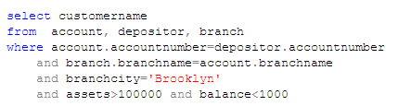
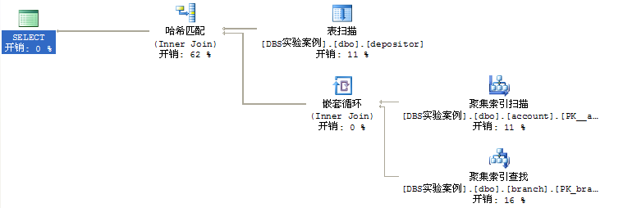
Example: Query Evaluation Plan in SQL Server

Slide 83
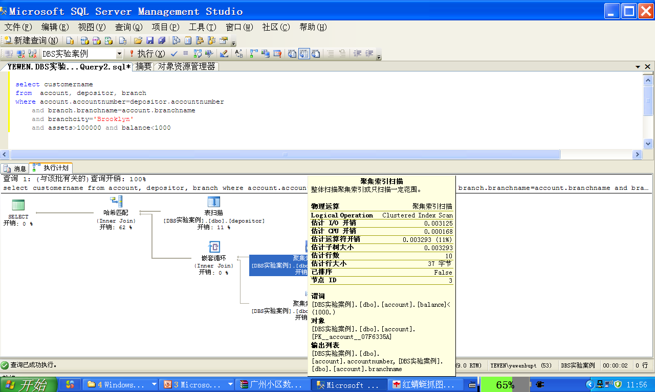
选择下移
投影下移

Slide 84
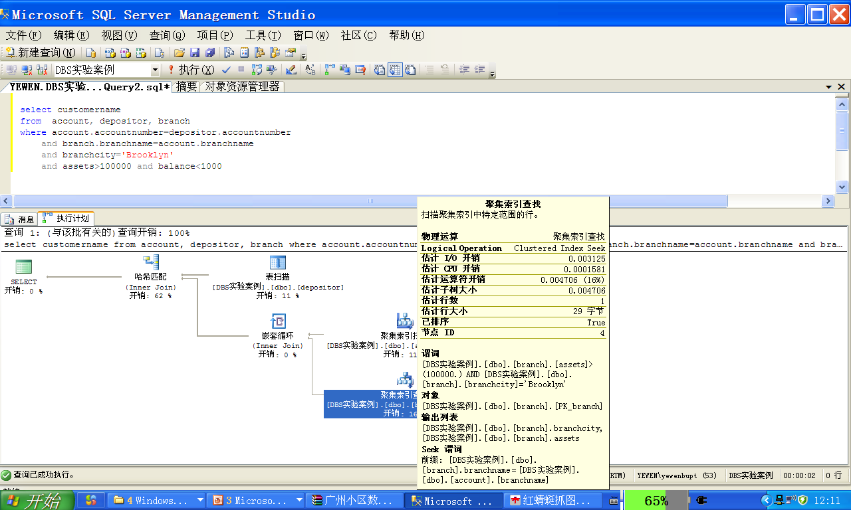
选择下移
投影下移？

Slide 85
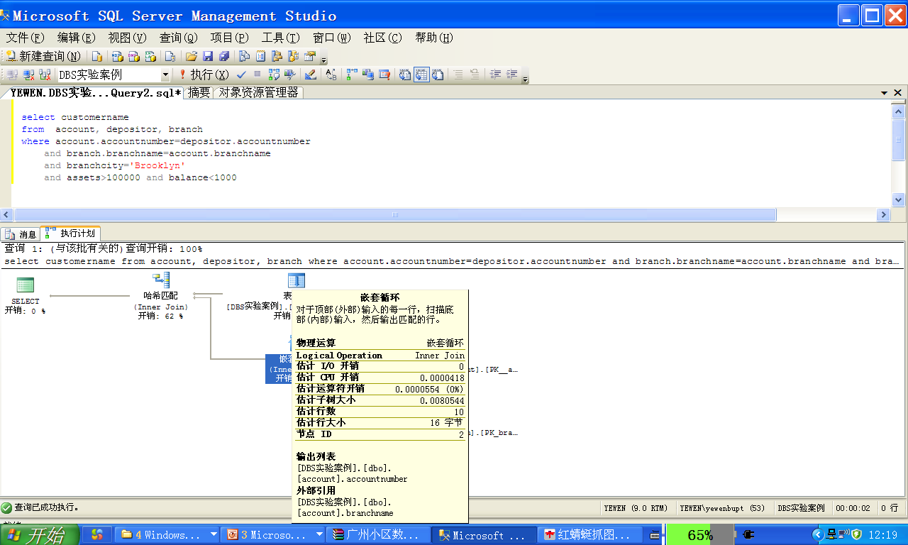
连接实现方式
投影下移

Slide 86
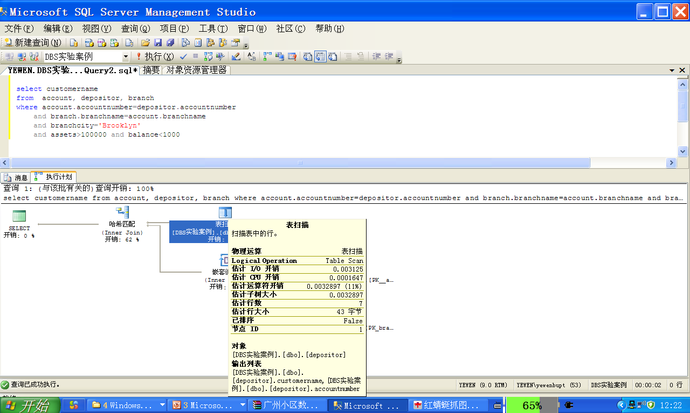
投影下移？

Slide 87
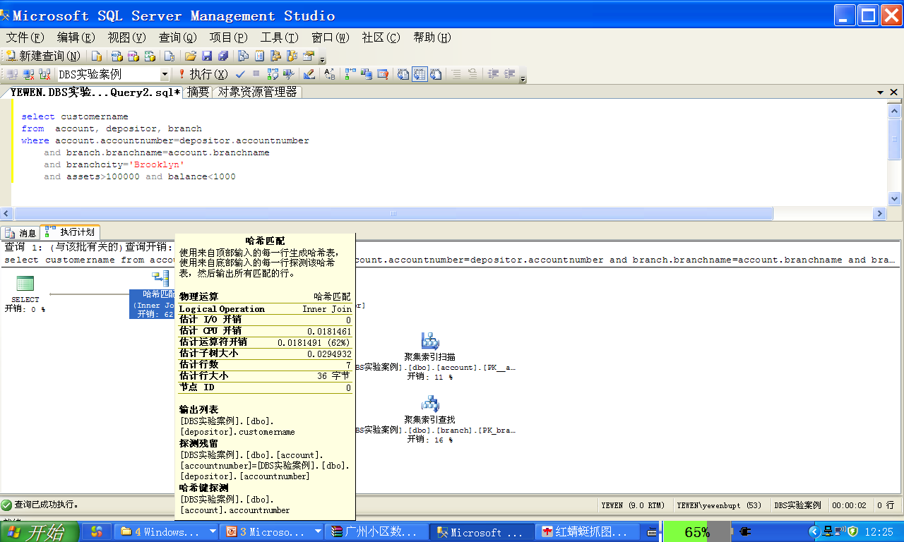
连接+投影

Slide 88
16.4.4 Optimizing Nested Subqueries
Nested query example: select name from instructor where exists (select * from teaches where instructor.ID = teaches.ID and
teaches.year = 2007)
Conceptually, nested subquery is executed once for each tuple (e.g. in instructor) in the cross-product generated by the outer level from clause
such evaluation is called correlated evaluation
correlated evaluation may be quite inefficient and expensive
结论：
不要在where子句中使用nested subquery，改为：
用from子句多表查询替代

Slide 89
实验八 查询分析优化——多表嵌入式SQL查询
结论：
在SQL查询中，涉及多表查询时，避免在where子句中采用in 嵌入式查询，改为直接在from子句中定义多个查询对象表
实际系统中，如SQL Server等DBMS有时会将嵌入式查询转换为连接查询；但可能出现两者查询性能相同，甚至嵌套查询性能更优的特殊情况
因此，掌握利用DBMS观察、分析SQL语句的查询执行计划，分析执行过程，选择优化的SQL语句实现方式

Slide 90
Appendix 16-2 分布式DBS查询代价与数据分布的关系【略】
分布式数据库系统DDBS中, 数据在各站点的分布和站点间通讯代价/传输时间将影响到整个查询代价
例.
S(S#，SNAME，AGE，SEX) , 10⁴个元组，站点A
C(C#，CNAME，TEACHER), 10⁵个元组，站点B
SC(S#，C#，GRADE), 10⁶个元组，站点A
元组平均长度100bit，站点间传输速率v = 10⁴ bit/s ，通 信延迟d=1s
假设无副本
查询要求
在支持分片透明性的DDBS（分布在A和B 2个站点）中，查询“所有选“MATH“的男生的学号和姓名”

Slide 91
分布式DBS查询代价与数据分布的关系
SQL（全局）查询语句
SELECT S#，SNAME
FROM S，SC， C
WHERE S.S# = SC.S# AND SC.C# = C.C# (连接条件)
AND SEX=M AND CNAME= MATH （选择条件）
查询代价(query cost)
只考虑通信代价
TC (x) =1s ╳ 传输次数 + 传输的元组bit数 ÷ 10⁴ bit/s

Slide 92
分布式DBS查询代价与数据分布的关系
策略1
将关系C传到A地，在A地进行查询处理
TC1 = 1s + 10⁵ ╳100 bit ÷ 10⁴ bit/s ≈ 10³ s ≈ 16.7 min
策略2
将关系S和SC传到B地，在B地进行查询处理
TC2 = 2s + （10⁴ +10⁶ ） ╳ 100 bit ÷ 10⁴ bit/s ≈10100 s≈28h
策略3
A地从关系SC、S中求出所有男学生的成绩元组，共10⁵个
根据元组中的C#, 向B地的C关系询问(应答过程) CNAME=MATH？共询问10⁵次
TC3 ≈ 2 ╳ 10⁵ ╳ 1 ≈ 2.3天

Slide 93
分布式DBS查询代价与数据分布的关系
策略4
在B地从关系C中求出CNAME=MATH的课程元组，假设有10个
根据C#询问A地的S、SC的连接，核实是否为选修MATH（SC.C#= C#?）的男生(S.SEX=M?)
TC4 ≈ 2 ╳ 10 ╳ 1 ≈ 20s
策略5
在A地从关系S、SC中求出男生的的课程元组，有10⁵个
将结果传到B地，在B地执行查询
TC5= 1s + 10⁵ ╳ 100 bit ÷ 10 ⁴bit/s ≈ 10³ s ≈ 16.7 m

Slide 94
分布式DBS查询代价与数据分布的关系
策略6
在B地从关系C中求出CNAME=MATH的课程元组，有10个
将结果传到A地，在A地执行查询
TC6 = 1s + 10 ╳100 bit ÷ 10⁴ bit/s ≈ 1s

Slide 96

Thanks for your attention

